Slide 1
Mainstreaming Sustainable PPPs
"
"
Natalia Korchakova-Heeb
Managing Director
SDG.17 Consulting GmbH
Спикер сессии:
«Перспективы применения offtake-контрактов в проектах ГЧП»
Online Forum PPP
2-ой Инвестиционный форум ГЧП
«ГЧП В ПЕРИОД ПАНДЕМИИ: ВЫЗОВЫ И ВОЗМОЖНОСТИ»

Slide 2
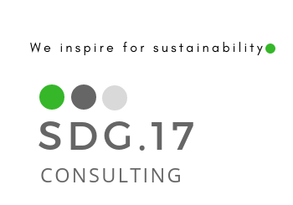
1.
Presentation of SDG.17 Consulting
2.
SDGs and PPPs
3.
SDGs Benchmarks for PPPs

Slide 3
SDG.17 Consulting GmbH

Slide 4
SDG.17 Consulting GmbH
SDG. 17 Consulting GmbH advocates policies and practices that encourage the development of low-carbon, climate-resilient infrastructure delivered through sustainable and people-first public-private partnerships.
SDG. 17 Consulting GmbH
We voluntary accept ISO 26000 as a reference document containing guidelines for implementing socially responsible behavior and the ten principles of the Global Compact with respect to human rights, labour, environment and anti-corruption.
SDG.17 Consulting GmbH
SDG.17 Consulting GmbH is a member of Alliance for Development and Climate, German PPP Association (BPPP e.V.), UN Women National Committee Germany e.V., German Health Alliance, Global Health Hub Germany, and Informal Interagency Task Team of the United Nations on Sustainable Sourcing in the Health Sector (SPHS).

Slide 5
Our Three Pillars
Public-Private Partnerships
Sustainable& Innovative Healthcare
Sustainable Development Goals
Translation of SDGs for infrastructure projects
Assisting countries in improving their infrastructure through PPP model
Digital solutions for healthcare sector is an opportunity for developing countries to make leapfrogging

Slide 6
PPP-Speaker of German Health Alliance
Founder of PPPHealth4All (https://ppphealth4all.de) in Germany,
Member of the Steering Committee of the World Association of PPP Units an PPP professionals
Coordinator of Working Group on Partnerships for Global Health and Working Group on Digital Solutions for global health within Global Health Hub Germany.
Recipient of numerous awards, including award for Entrepreneurial Excellence (USA), a medal from the European Commission for loyal services (EU), governmental awards and is also a renowned international speaker.
Mrs. Korchakova-Heeb established in 2018 the company SDG.17 Consulting GmbH (Frankfurt am Main, Germany) to promote sustainable PPPs as an instrument to achieve Sustainable Development Goals and to assist with development of pipeline of sustainable projects in social infrastructure in the developing countries.
Natalia Korchakova-Heeb
Managing Director
SDG.17 Consulting GmbH
Staufenstraße 33, 60323
Frankfurt am Main, Germany
info@sdg17consulting.de

Slide 7
Sustainable Development Goals and PPPs

Slide 8
What is sustainability?
Notes:
Sustainable infrastructure (SI) is an essential foundation for achieving inclusive and sustainable growth, the Sustainable Development Goals (SDGs), and the objectives of the Paris Agreement.

Slide 9
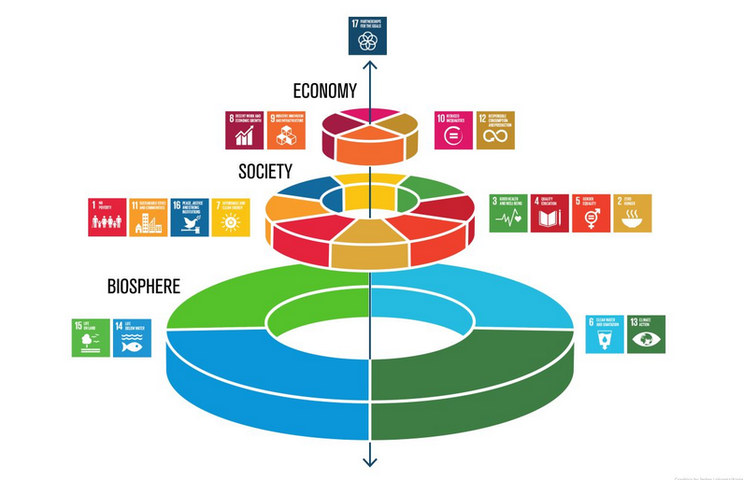
What is Sustainability?
Social
Environment
Economic

Slide 10
PPPs as an Instrument to Achieve SDGs
PPP projects should demonstrate relevance to SDGs and reflect on their contribution to achievement of SDGs.
Alignment and Contribution to SDGs
Access to Financing
Demonstrating alignment with the SDGs helps governments to attract financing from multilateral development banks and funds, impact investors.
Notes:
Closing the infrastructure gap must go beyond building more roads, solar farms, and water treatment systems; it requires increasing the quality, efficiency, and innovation of service delivery and transforming how public and private project developers plan, procure, finance, and operate assets that meet all sustainability criteria (social, environmental, institutional, and economic-financial aspects across the asset lifecycle).

Slide 11
Some Selected SDGs for PPP Projects
SDG 1
SDG 3
SDG 6
SDG 7
Poverty reduction
Ensure healthy lives and promote well-being for all at all ages
.
Clean water and sanitation
.
Affordable and clean energy
SDG 17.17
Encourage and promote effective public, public-private and civil society partnerships
SDG 9.1
SDG 10
SDG 12
SDG13
Development of resilient infrastructure
Reduced Inequalities
Responsible Consumption
Climate Action

Slide 12
Selected SDG Benchmarks for PPPs

Slide 13
Important Notions
People-first PPPs
Impact Investing
Sustainable Infrastructure
Quality Infrastructure
Green Infrastructure
Sustainable Finance
Sustainable Procurement
One Planet Concept
Resilient Infrastructure & Climate Risks
Circular economy
Smart Infrastructure
ESG
.

Slide 14
Indicators/Frameworks | Developed by
Green, Resilient, Inclusive and Sustainable (GRIS) Indicators (2019) | Asian Development Bank
Infrastructure Indicators within the Compendium of Indicators (2019) | European Bank for Reconstruction and Development (EBRD
Sustainable Infrastructure Framework (SIF) | Inter-American Development Bank (IDB)
Quality Infrastructure Indicators Framework (QII) (2020, forthcoming) | International Finance Corporation (IFC)
Aligned Set of Sustainability Indicators (ASSI) (August 2019, rev. April 2020) | Public-Private Infrastructure Advisory Facility (PPIAF)

Slide 15
Sustainability rating tools | Country of Origin
Infrastructure Sustainability Rating Tool | Australia
CEEQUAL | UK
ENVISION | USA
SURE Infrastructure Resilience Standard | Switzerland

Slide 16
Sustainable Sustainable Sustainable Sustainable Sustainable Sustainable Sustainable Planning Procurement Financing Design &Architecture Construction O&M Decommissioning
Sustainable Lifecycle for Infrastructure PPPs
Sustainable
Planning
Sustainable
Procurement
Sustainable
Financing
Sustainable
Design
Sustainable Construction
Sustainable
O&M
Sustainable
Decommissioning
Impact
Assessment
Public Partner:
National &
local
governments
Public Partner: National
& local governments
Sustainable Investors,
banks
Design Bureaus and Architects
Construction
companies
Facility Management
Companies,
Construction
companies
Public Partner:
National &
local
governments
SUPPLY CHAIN
Sub-contractors

Slide 17
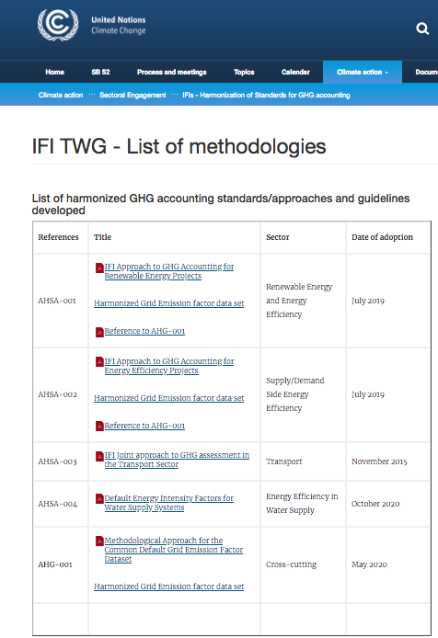
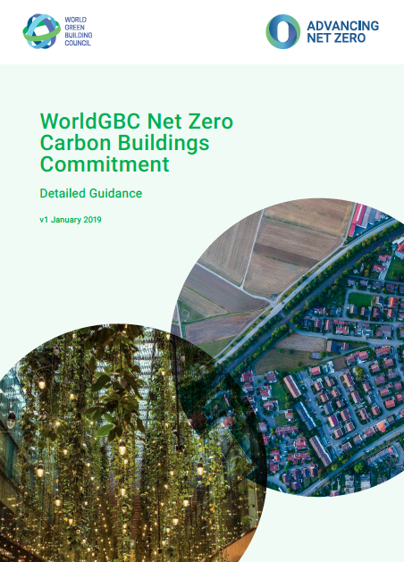
BENCHMARK CO2 Emissions
What to measure? tCO2/year or tCO2-eq/year
When? through the project life-cycle
How?
Notes:
Infrastructure projects should help reduce Greenhouse Gas (GHG) emissions. Infrastructure projects should be aligned both with national GHG reduction policies and targets and international commitments such as the Paris Agreement to combat global warming. GHG emissions assessments should consider the full life cycle of the project.

Slide 18
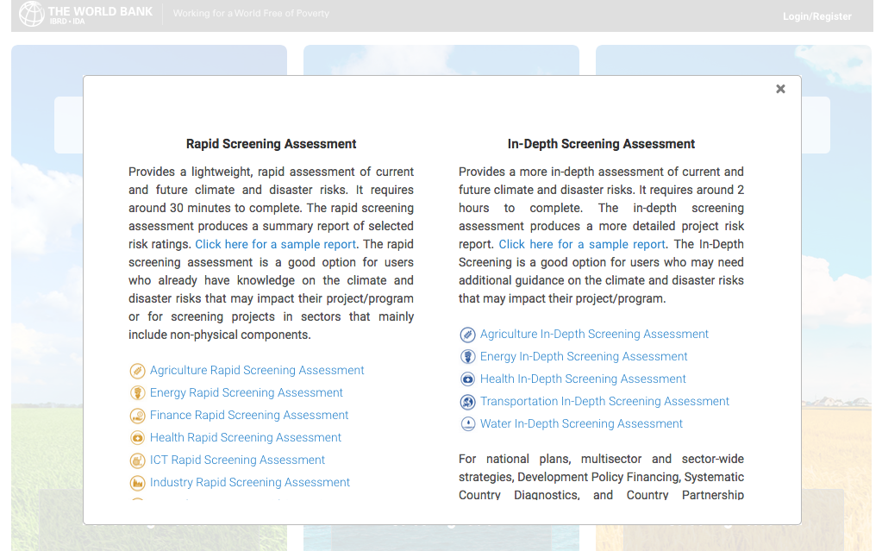
BENCHMARK Climate Resilience
What to measure?
climate and geophysical hazards
impacts on the project’s physical components
adaptive capacity
When? through the project life-cycle but most importantly, project design. Using your risk screening analysis to inform follow-up feasibility studies and technical assessments.
How?
WB In-depth assessment tools
Implementation of the Sendai Framework for Disaster Risk Reduction
OECD Recommendation on the Governance of
Critical Risks
OECD Framework on the Governance of Infrastructure
Central Asia Centre for Emergency Situations and Disaster Risk Reduction in Almaty, Kazakhstan
Notes:
Incorporating climate change considerations into existing PPP policy frameworks to enable integration of climate resilience into planning and design of new PPP projects and ideally also revising frameworks of existing projects
Climate resilience mainstreamed in public investment management systems, specifically in engineering standards, for the development of all kinds of infrastructure, including PPPs
Policy alignment between climate change policies, national infrastructure planning and SDG-reporting
Allocation of Climate risks in PPP healthcare project
Identification of climate risks within PPP
Assessment of climate risks
Allocation of climate risks
Climate risk mitigation
Climate risk monitoring and review

Slide 19
BENCHMARK Climate Risks
Considering climate risks and resilience within PPP projects:
Incorporating climate change considerations into existing PPP policy frameworks to enable integration of climate resilience into planning and design of new PPP projects and ideally also revising frameworks of existing projects
Climate resilience mainstreamed in public investment management systems, specifically in engineering standards, for the development of all kinds of infrastructure, including PPPs
Policy alignment between climate change policies, national infrastructure planning and SDG-reporting
Identification of climate risks within PPP
Allocation of climate risks in PPP projects
Assessment of climate risks
Climate risk mitigation
Climate risk monitoring and review
Reflection of requirements in procurement requirements
Resilience-building adaptations to infrastructure are not expensive if incorporated early in the project lifecycle (1 -2% percent)
Lenders should require consideration of climate risk and resilience as lending criteria
Climate financing for PPPs Green Climate Fund, Climate Investment Funds, and Green Bonds
Notes:
Incorporating climate change considerations into existing PPP policy frameworks to enable integration of climate resilience into planning and design of new PPP projects and ideally also revising frameworks of existing projects
Climate resilience mainstreamed in public investment management systems, specifically in engineering standards, for the development of all kinds of infrastructure, including PPPs
Policy alignment between climate change policies, national infrastructure planning and SDG-reporting
Allocation of Climate risks in PPP healthcare project
Identification of climate risks within PPP
Assessment of climate risks
Allocation of climate risks
Climate risk mitigation
Climate risk monitoring and review

Slide 20
Benchmark: Use of Materials/Waste Tonnes (as % of total)/Tonnes/year
Project should achieve an average 90% or greater overall diversion from landfill, incineration (WTE), and the environment for solid, non-hazardous wastes (referred to as “materials” herein) for the most recent 12 months. Diverted materials are reduced, reused, recycled, composted and/or recovered for productive use in nature or the economy.
Reduction of Waste
Reuse
Composting
Recycling
Anaerobic Digestion
Other Procesing Technologies
https://true.gbci.org/sites/default/files/resources/TRUE_RatingSystemGuide_r1.pdf
Notes:
REDUCTION – Efforts to reduce the generation of materials can be recognized in the diversion calculations provided that the reductions are documented from an established baseline representing previous operations • REUSE – Avoided disposal resulting from the reuse of items• COMPOSTING – Organic matter decomposed by micro-organisms into a soil amendment• RECYCLING – Materials converted into manufacturing feedstock material and used in creation of new products (excludes use as fuel substitute or for energy production)• ANAEROBIC DIGESTION – Organic matter broken down by microorganisms into a soil amendment in the absence of oxygen (byproducts must be recovered for productive use in nature)• OTHER PROCESSING TECHNOLOGIES, not including incineration or waste-to-energy, in which the end product is recovered for productive use in nature or the economy

Slide 21
BENCHMARK N5 Circular Economy
Refurbishing/re-manufacturing of medical equipment (Philips, Siemens, GE)
No use of plastic in the EU by 2021. Complete ban on plenty of single- use products, the use of plastics for which no alternatives currently exist – mostly food packaging – will have to be cut down by 25 percent by 2025.
Recycling of medical, food and other waste- concept of circular economy
Use of recyclable materials- 25% of the hospital waste is plastic
Reflection of those requirements in procurement requirements

Slide 22
BENCHMARK N Biodiversity
What to measure?
number of endangered species directly or indirectly
impacted by the project
percentage of land disturbed/protected
measures on the protection of wildlife and preservance of ecological
corridors
When? planning, design, construction and operation phases of the project
How?
geospatial methods and tools for Green Infrastructure mapping
highlighting the importance of avoiding and mitigating negative impacts on biodiversity.
biodiversity management plan
monitoring programs
Green Infrastructure
Notes:
How: biodiversity management plan and monitoring programs, highlighting the importance of
avoiding and mitigating negative impacts on biodiversity.

Slide 23
BENCHMARK Accesibility and Jobs Creation
What to measure?
Service access, quality, reliability, and affordability
When: project construction, operation and maintenance
How?
Short (max.600 m) accessibility to the closest point of public transport (bus, tram, train, etc.) reducing the distance to the facility and the service access cost
Quality of the road connection (connection to the developed main road, motorway access via a good arterial road)
Individual parking concept (parking for people with mobility limitation, female parking, family parking, bicycle parking, temporary parking for emergency physician, delivery, etc.)
G20 PRINCIPLES FOR QUALITY INFRASTRUCTURE INVESTMENT
Maximizing the positive impact of infrastructure to achieve sustainable growth and development;
Raising economic efficiency in view of life-cycle cost;
Integrating environmental considerations in infrastructure investments;
Building resilience against natural disasters and other risks;
Integrating social considerations in infrastructure investment;
Strengthening infrastructure governance
(based on German Health Alliance GREEN HOSPITAL STUDY)

Slide 24
BENCHMARK N1 Energy-efficiency
Passive House Standard - efficient thermal insulation combined with a ventilation system
Nearly zero energy standard - by 2020 the specifications of the German Energy Saving Ordinance. They combine the thermal insulation on the facade and roof for example with triple insulated glazing, a heat pump and solar thermal energy for water heating
Energy Plus standard- more energy is produced by the hospital than consumed (due to the use of renewable energy)
Use of e-mobility in buildings - supporting the rollout of e-mobility infrastructure such as e-charging points in hospitals.

Slide 25
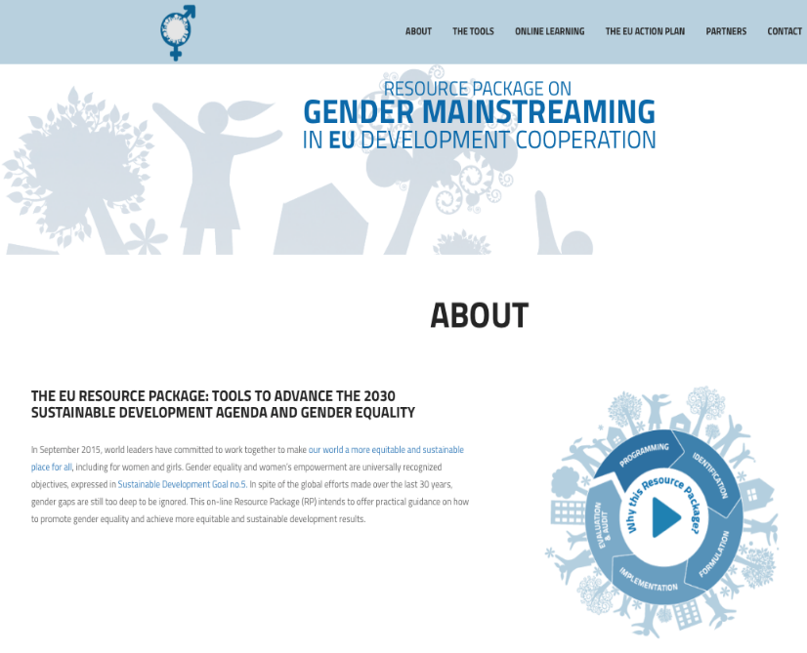
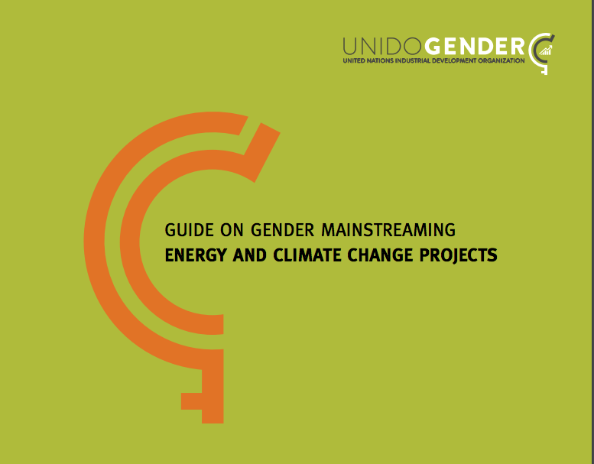
BENCHMARK N1 Gender Equality

Slide 26
Conclusions
Experience shows that there is a lack of understanding of SDGs, misinterpretation and greenwashing
New way of thinking is required for design and implementation of PPP projects. New competencies are required for PPP professionals.
Public officials working with PPPs should receive adequite training and support to be able to incorporate SDG matrix into the practice.

Slide 27
Thank You! Questions?

